Slide 1

Intro to
Programming
With python
Sequences:
Transforming part III
Wednesday, October 26 2024 TOH210
Notes:
Layout objects pulled from: https://slidesgo.com/
All icons are from: https://thenounproject.com/

Slide 2
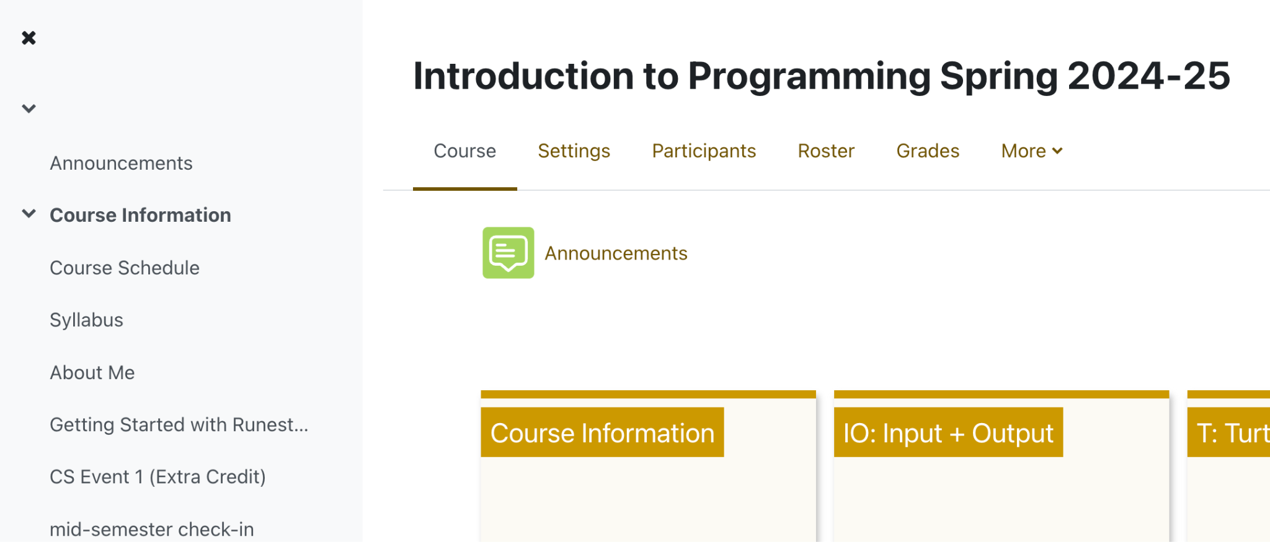

colab workbook
click for access
found on Moodle under this week
Take a few minutes to fill out mid-semester check-in up on Moodle under Course Information!

Slide 3

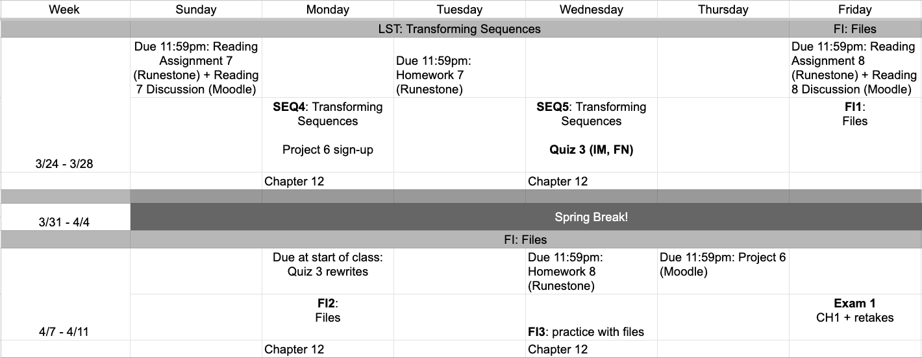
This week
google sheet link
Notes:
https://docs.google.com/forms/d/e/1FAIpQLSe3OloPAJSid4n6cyU_4qXpRWU7FOSmP7IVdRS_vh9cvYd9zQ/viewform?usp=sharing

Slide 4

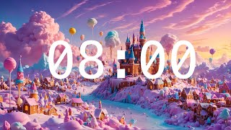
Warmup
🐦‍⬛🐦‍⬛🐦‍⬛🐦‍⬛🦆
Write a program that does the following:
Create a list called odds containing the odd numbers 3 through 21
Append ‘odd’ to the end of the list.
Remove the number at index 5, and append it to the end of the list.
Remove the items at indices 2 through 7.
Insert the string ‘🦆’ at index 5.
Remove the number 5 from the list.
Print the list.
List methods:
my_list.append(item)
my_list.insert(index, item)
my_list.remove(item)
my_list.pop(index)
my_list.pop()
del my_list[index]
del my_list[start:stop]
Remember we can create lists by list(range(start, stop, step))
[3, 21, 'odd', 13, '🦆']

Slide 5
Takeaways from last time
list methods that add or remove items from a list
functions that change a list vs functions that make a new list
alias vs clone

Slide 6
changing a list
lst = ["a", "b", "c", "d"]
0 1 2 3
“A”
“b”
“c”
“d”
lst[0] = "A"
What about changing a string?
text = "abcd"
ERROR
text[0] = "A"
We can’t do assignment like this with characters in a string
This is because lists are mutable. Mutable means that we can make changes directly to this data after they’ve been created. Strings, however, are not mutable. To change a string, you’ll need to create a new one

Slide 7
def change_first(text:str,char:str)->None:
"""Takes a string and a character as an argument,
and changes the argument text so that the first character of text is the given character"""
So how can we transform strings
will not work since no new string is created
Well we will need to create new strings!
And with that, we will need to be able to return those new strings.
def change_first(text:str,char:str)->str:
"""Takes a string and a character as an argument,
and changes the argument text so that the first character of text is the given character"""
will work since new string is created and returned

Slide 8
def change_first(text:str,char:str)->str:
"""Takes a string and a character as an argument,
and changes the argument text so that the first
character of text is the given character"""
new_text = char + text[1:]
return new_text
phrase = "I like to move it move it"
print(change_first(phrase, "U"))
print(phrase)
"U like to move it move it"
"I like to move it move it"

Slide 9
def mirror_text(text: str) -> str:
"""Takes a string and returns a new string
that mirrors the original, with the second
half being the reverse of the first half.
"""
return text + text[::-1]
phrase = "hello"
print(mirror_text(phrase))
print(phrase)
"helloolleh"
"hello"

Slide 10
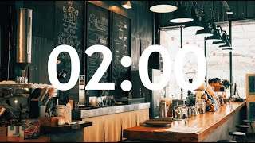
🦆 around and find out
Let’s create a function to randomly replace some letters from a text with some ducks 🦆
Randomly getting a number
import random
random.uniform(0,1)
Setting up our strings
text = "hello"
new_text =
Fill in the blanks:
for letter in text:
if random.uniform(0,1)>____:
new_text += ____
else:
new_text += ______
0.5
""
"X"
0.1428235156429093
0.455366066276903
letter
0.813013902480166
We're going to replace about half of the letters in text.
To do this, we'll go through text and if the random float we generate is over 0.5, we're going to add an "X" to new_text, otherwise add the original letter

Slide 11
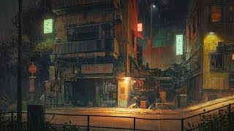
🦆 around and find out
Let’s create a function to randomly replace some letters from a text with some ducks 🦆
Let’s put it all together! Create a function ducked_up that takes in a string and returns a ducked-up string.
An example is below:
greeting = "bonjour"
print(ducked_up(greeting))
Note: if you rerun you’ll get a new ducked up string each time!
Fill in the blanks:
for letter in text:
if random.uniform(0,1)>0.5:
new_text += "🦆"
else:
new_text += letter
🦆onjou🦆
🦆🦆🦆j🦆🦆🦆
b🦆nj🦆u🦆
If you have time, try adding some of the additional parameters at the bottom of the workbook

Slide 12

before next time
Finish workbook

Slide 13
import random
def ducked_up(text:str, threshold:float)->str:
""" Censors some of the text"""
new_text = ""
for letter in text:
if random.uniform(0,1)<threshold:
new_text += "🦆"
else:
new_text += letter
return new_text
ducked_up("bonjour")
odds = list(range(3,22,2))
odds.append('odd')
item_5 = odds.pop(5)
odds.append(item_5)
del odds[2:8]
odds.insert(5, '🦆')
odds.remove(5)
odds
b🦆njour
[3, 21, 'odd', 13, '🦆']
bon🦆🦆ur

Slide 14
import random
def ducked_up(text:str, emoji:str = "duck", threshold:float = 0.5)->str:
"""Replaces some of the text with the emoji, based off the threshold passed in. If the emoji string isn't one of the options, an X will be used. This returns the new string"""
new_text = ""
for letter in text:
if random.uniform(0,1)<threshold:
if emoji == "duck":
new_text += "🦆"
elif emoji == "octopus":
new_text += '🐙'
elif emoji == "butterfly":
new_text += '🦋'
else:
new_text += 'X'
else:
new_text += letter
return new_text
you can add defaults to parameters to make them optional!
Example function calls
ducked_up("bonjour")
ducked_up("bonjour", "duck")
ducked_up("bonjour", "duck", 0.2)
ducked_up("bonjour", "butterfly")
ducked_up("bonjour", "snail")
🦆🦆njo🦆r
bonjo🦆r
bo🦋jo🦋r
XXnXXuX

